Slide 1
Microservices and DevOps
DevOps and Container Technology
Container Orchestration
Henrik Bærbak Christensen

Slide 2
From One to Many
Container technologies like Docker moves the start-up time of ‘a server’ from hours to seconds
Consider installing separate machines for SkyCave
Install Ubuntu, Redis, start
Install Ubuntu, Web framework, Quote Service, start
Install Ubuntu, java, gradle, skycave daemon, start
However, we still do quite a few manual steps as we focus on each individual container
Run Redis container, run quote service, manage network, run daemon
And worse – it was still tied to one piece of hardware
Which sort of defeats the whole purpose of scaling...

Slide 3
From One to Many
Orchestration tools
That is, a ‘dashboard’ of sets of servers/hardware that allows automatic distribution and scaling of containers...
Newman: deployment interface
One command line that deploys the architecture
[Janakiram, 2016]

Slide 4
Central Concepts
Provided Functionality/Tooling
Automate all aspects of deployment and monitoring
Placement of service on ‘convenient’ server
Deployment and starting services
State-state activities: update, roll-back, health monitoring
Infrastructure-as-code Declarative configuration
State what you want, not how to do it
The hierarchical ‘YAML’ format predominant
YAML = YAML Ain't Markup Language ☺

Slide 5
Central Concept
Rules and Constraints
Service placements can be controlled by rules/constraints
”put mongodb on a machine with large hard disks”
”put master and slave on different hardware”
”make three replicas of this service”
Provisioning
Distribute services ‘efficiently’ across available hardware
Discovery
Services must interact, so some form of DNS is required internally in the cluster to facilitate that

Slide 6
Central Concepts
Health Monitoring
Track and monitor health of services, containers, and hosts
Relocate containers from failing hosts
Relaunch replacement container if any crashes
That is, actively striving to provide the configuration set forth by the infrastructure-as-code declarative configuration…

Slide 7
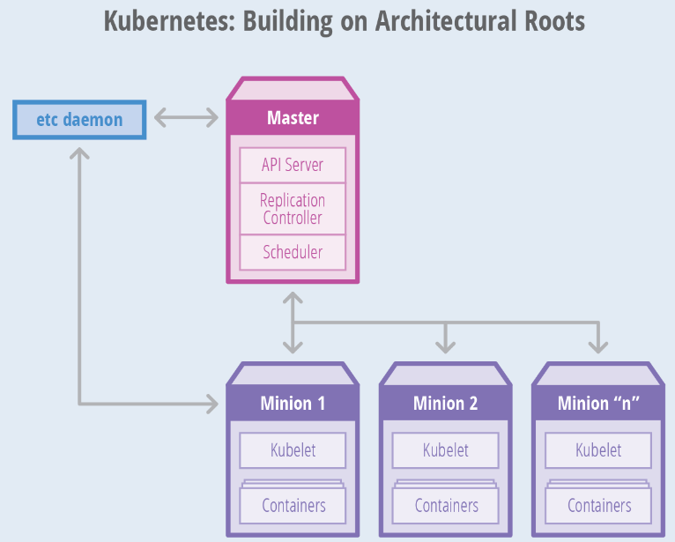
Candidates
Kubernetes
Google
Oldest, proven in war ☺
Open source
Steep learning curve ☹
Review ‘Docker Swarm vs. Kubernetes’ by Pedersen & Gribenco, on https://baerbak.cs.au.dk/c/ProjectReports/

Slide 8
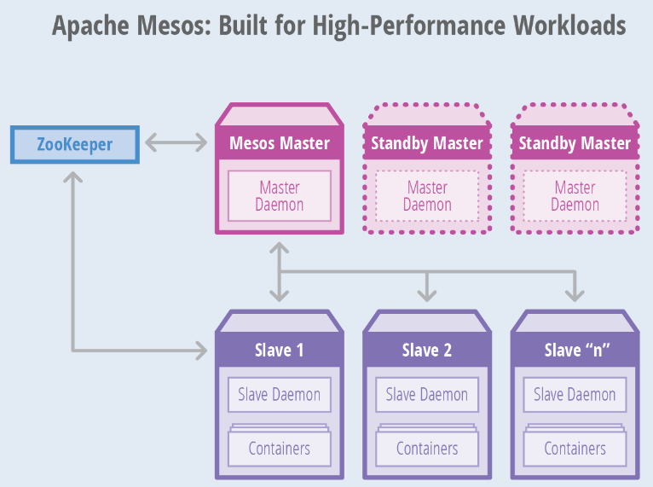
Candidates
Apache Mesos
High availability focus...

Slide 9
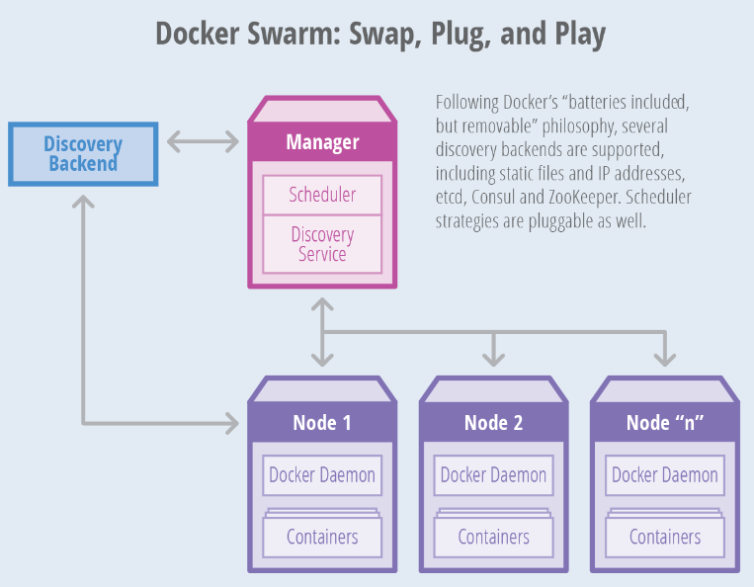
Candidates
Swarm
Highly integrated with Docker
Infrastructure-as-code
Less steep learning curve
Claim: Kubernetes compliant
Caveat:
Rumors that it ‘does not work’ in practice?
It does!

Slide 10
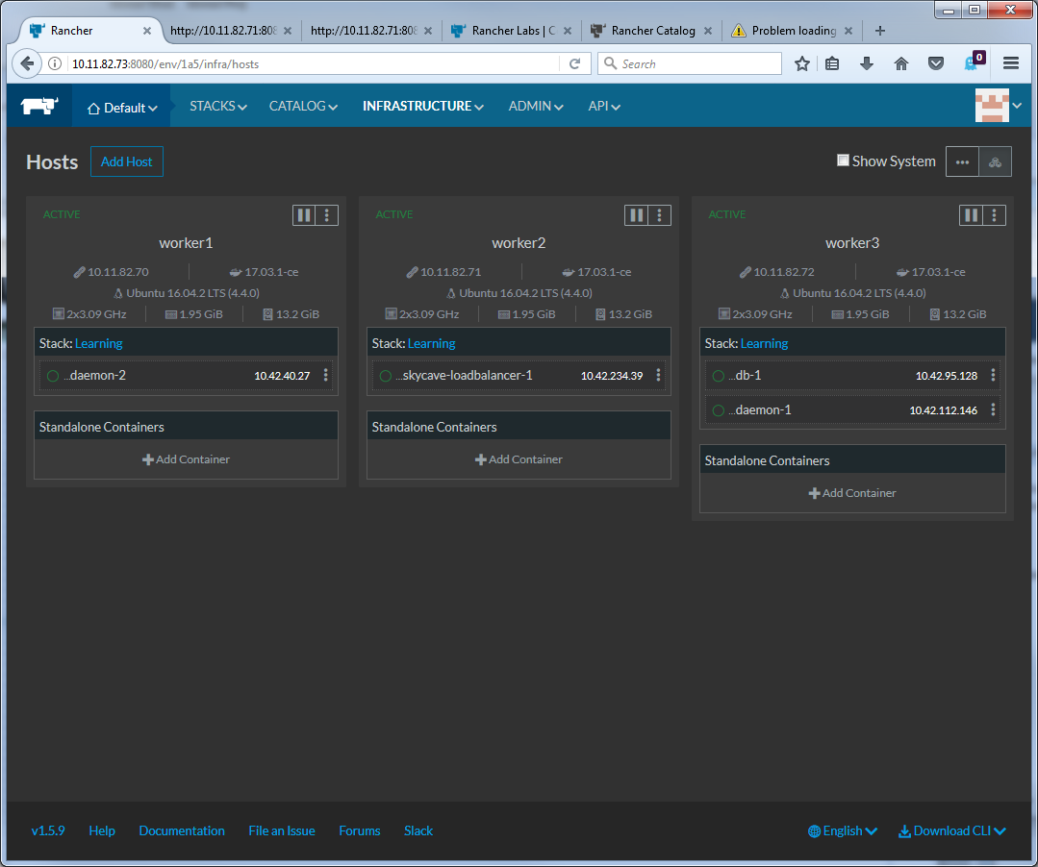
Candidates
Rancher
A docker container having a Web gui
‘click-deploy’ your containers, add build in load balancer
And off you go...

Slide 11
Our Choice
We go for Swarm because
Part of the Docker infrastructure
Shallower learning curve
Very easy to deploy locally on your own machine
No hazzle to create a real, costly, cluster
Downside
Kubernetes seems to be winner that takes all…

